Slide 1
Data Management and its Components
Pravin Y Pawar

Slide 2
Data Management
What and Why?
Data management is the practice of ingesting, processing, securing and storing an organization’s
data,
where it is then utilized for strategic decision-making to improve business outcomes
Over the last decade, developments within hybrid cloud, artificial intelligence, the Internet of Things
(IoT), and edge computing have led to the exponential growth of big data
creating even more complexity for enterprises to manage
A data management discipline within an organization has become an increasing priority as this growth
has created significant challenges,
such as data silos, security risks, and general bottlenecks to decision-making
Teams address these challenges head on with a number of data management solutions, which are
aimed to clean, unify, and secure data
Allows leaders to glean insights through dashboards and other data visualization tools, enabling informed business
decisions
Empowers data science teams to investigate more complex questions, allowing them to leverage more advanced
analytical capabilities

Slide 3
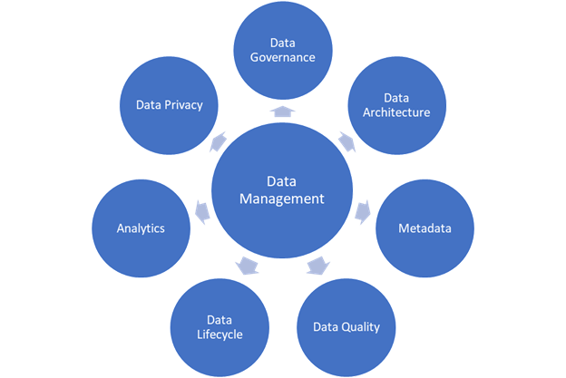
Data Management Framework
Components
Source : trellance

Slide 4
Data Management Framework
Components : described
Data Governance
provides the overarching support to data management through stewardship, policies, processes, standards, and adherence to leading practices
Data Architecture
provides the infrastructure for the storage, integration, and use of data throughout the organization
Metadata
allows to use data more efficiently by providing critical information about data attributes
Data Quality
provides the structure necessary to have data that fulfills the needs of the business
Data Lifecycle
follows the data throughout the company, providing integrity from the initial introduction into the company through the final deletion from the company
Analytics
applies statistical and visualization techniques that lead to valuable insights that can help the company make better business decisions.
Data Privacy
supports the needs of the business to share data internally and externally.

Slide 5
Data Management Components
The scope of a data management discipline is quite broad!
A strong data management strategy typically implements the following components to streamline their strategy and operations throughout an organization:
Data processing
Data storage
Data governance
Data security

Slide 6
Data Management Components(2)
Data processing
In this stage,
Raw data is ingested from a range of data sources, such as web APIs, mobile apps, Internet of Things (IoT) devices, forms, surveys, and more
Then, usually processed or loaded, via data integration techniques, such as extract, transform, load (ETL) or extract, load, transform (ELT)
ETL has historically been the standard method to integrate and organize data across different datasets
ELT has been growing in popularity with the emergence of cloud data platforms and the increasing demand for real-time data
Independently of the data integration technique used,
the data is usually filtered, merged, or aggregated during the data processing stage to meet the requirements for its intended purpose,
which can range from a business intelligence dashboard to a predictive machine learning algorithm

Slide 7
Data Management Components(3)
Data storage
Data can be stored before or after data processing, the type of data and purpose of it will usually dictate the storage repository that is leveraged
Data warehousing
requires a defined schema to meet specific data analytics requirements for data outputs,
such as dashboards, data visualizations, and other business intelligence tasks
which are usually directed and documented by business users in partnership with data engineers,
who will ultimately execute against the defined data model
underlying structure of a data warehouse is typically organized as a relational system (i.e. in a structured data format),
sourcing data from transactional databases
Other storage systems, such as data lakes,
incorporate data from both relational and non-relational systems, becoming a sandbox for innovative data projects
benefit data scientists in particular, as they allow them to incorporate both structured and unstructured data into their data science projects

Slide 8
Data Management Components(4)
Data governance
A set of standards and business processes which ensure that data assets are leveraged effectively within an organization
includes processes around data quality, data access, usability, and data security
Data governance councils
tend align on taxonomies to ensure that metadata is added consistently across various data sources.
help to define roles and responsibilities to ensure that data access is provided appropriately; this is particularly important to maintain data privacy.

Slide 9
Data Management Components(5)
Data security
Data security sets guardrails in place to protect digital information from unauthorized access, corruption, or theft
more scrutiny is placed upon the security practices of modern businesses
to ensure that customer data is protected from cybercriminals or disaster recovery incidents
While data loss can be devastating to any business, data breaches, in particular, can reap costly consequences from both a financial and brand standpoint
Data security teams can better secure their data by leveraging encryption and data masking within their data security strategy.

Slide 10
Data Platform
Data management tools require a robust data and computing infrastructure
that scales to meet business demand without impacting performance
Most companies now build a data lake to store raw data of any type from any system, often in Hadoop
but increasingly in a public cloud (e.g., Microsoft Azure)
Companies also build
data warehouses to support performance reporting (e.g., reports, dashboards, and light analysis) on structured data
temporary sandboxes for testing, analysis, and prototyping purposes
Data environments require
fast query processing
large storage capacity
elastic computing
In-memory caches
columnar storage
and large in-memory data grids and computing clusters

Slide 11
Thank You!
Reference:
What is data management?
https://www.ibm.com/in-en/topics/data-management
In our next session:

